Slide 1

Big Data Infrastructure
CS 489/698 Big Data Infrastructure (Winter 2016)
Week 7: Analyzing Relational Data (3/3)
February 25, 2016
Jimmy Lin
David R. Cheriton School of Computer Science
University of Waterloo
These slides are available at http://lintool.github.io/bigdata-2016w/
This work is licensed under a Creative Commons Attribution-Noncommercial-Share Alike 3.0 United States See http://creativecommons.org/licenses/by-nc-sa/3.0/us/ for details

Slide 2
MapReduce: A Major Step Backwards?
MapReduce is a step backward in database access:
Schemas are good
Separation of the schema from the application is good
High-level access languages are good
MapReduce is poor implementation
Brute force and only brute force (no indexes, for example)
MapReduce is not novel
MapReduce is missing features
Bulk loader, indexing, updates, transactions…
MapReduce is incompatible with DMBS tools
Source: Blog post by DeWitt and Stonebraker

Slide 3
Hadoop vs. Databases: Grep
SELECT * FROM Data WHERE field LIKE ‘%XYZ%’;
Source: Pavlo et al. (2009) A Comparison of Approaches to Large-Scale Data Analysis. SIGMOD.

Slide 4
Hadoop vs. Databases: Select
SELECT pageURL, pageRank
FROM Rankings WHERE pageRank > X;
Source: Pavlo et al. (2009) A Comparison of Approaches to Large-Scale Data Analysis. SIGMOD.

Slide 5
Hadoop vs. Databases: Aggregation
SELECT sourceIP, SUM(adRevenue)
FROM UserVisits GROUP BY sourceIP;
Source: Pavlo et al. (2009) A Comparison of Approaches to Large-Scale Data Analysis. SIGMOD.

Slide 6
Hadoop vs. Databases: Join
SELECT INTO Temp sourceIP, AVG(pageRank) as avgPageRank, SUM(adRevenue) as totalRevenue
FROM Rankings AS R, UserVisits AS UV
WHERE R.pageURL = UV.destURL AND UV.visitDate BETWEEN Date('2000-01-15’) AND Date('2000-01-22’) GROUP BY UV.sourceIP;
SELECT sourceIP, totalRevenue, avgPageRank FROM Temp ORDER BY totalRevenue DESC LIMIT 1;
Source: Pavlo et al. (2009) A Comparison of Approaches to Large-Scale Data Analysis. SIGMOD.

Slide 7

Hadoop is slow...
Source: Wikipedia (Tortoise)

Slide 8

Something seems fishy…
Source: Wikipedia (Fish)

Slide 9
Why was Hadoop slow?
Integer.parseInt
String.substring
String.split
Hadoop slow because string manipulation is slow?

Slide 10
Key Ideas
Binary representations are good
Binary representations need schemas
Schemas allow logical/physical separation
Logical/physical separation allows you to do cool things

Slide 11
Thrift
Originally developed by Facebook, now an Apache project
Provides a DDL with numerous language bindings
Compact binary encoding of typed structs
Fields can be marked as optional or required
Compiler automatically generates code for manipulating messages
Provides RPC mechanisms for service definitions
Alternatives include protobufs and Avro

Slide 12
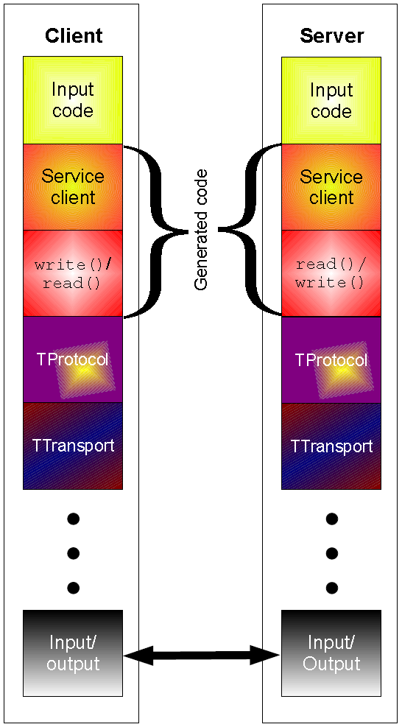
Thrift
struct Tweet {
1: required i32 userId;
2: required string userName;
3: required string text;
4: optional Location loc;
}
struct Location {
1: required double latitude;
2: required double longitude;
}

Slide 13
Why not…
XML or JSON?
REST?

Slide 14
Logical
R₁
R₂
R₃
Physical
How bytes are actually represented in storage…

Slide 15
Row vs. Column Stores
R₁
R₂
R₃
R₄
Row store
Column store

Slide 16
Row vs. Column Stores
Row stores
Easier to modify a record: in-place updates
Might read unnecessary data when processing
Column stores
Only read necessary data when processing
Tuple writes require multiple operations
Tuple updates are complex

Slide 17
OLTP/OLAP Architecture
OLTP
OLAP
ETL (Extract, Transform, and Load)

Slide 18
Advantages of Column Stores
Inherent advantages:
Better compression
Read efficiency
Enables vectorized execution
These are well-known in traditional databases…

Slide 19
Row vs. Column Stores: Compression
R₁
R₂
R₃
R₄
Row store
Column store
This compresses better with off-the-shelf tools, e.g., gzip.
Why?

Slide 20
Row vs. Column Stores: Compression
R₁
R₂
R₃
R₄
Row store
Column store
Additional opportunities for smarter compression…

Slide 21
Columns Stores: RLE
Column store
Run-length encoding example:
is a foreign key, relatively small cardinality
(even better, boolean)
In reality:
…
Encode:
3
2
1 …

Slide 22
Columns Stores: Integer Coding
Column store
Say you’re coding a bunch of integers…

Slide 23
Remember this?
(week 4)

Slide 24
Advantages of Column Stores
Inherent advantages:
Better compression
Read efficiency
Enables vectorized execution

Slide 25
Putting Everything Together
SELECT big1.fx, big2,fy, small,fz
FROM big1
JOIN big2 ON big1.id1 = big2.id1
JOIN small ON big1.id2 = small.id2
WHERE big1.fx = 2015 AND big2.f1 < 40 AND big2.f2 > 2;
project
join
Remember this?
join
select
select
Build logical plan
project
project
Optimize logical plan
Select physical plan
big1
big2
small

Slide 26
Advantages of Column Stores
Inherent advantages:
Better compression
Read efficiency
Enables vectorized execution

Slide 27
val size = 100000000
var col = new Array[Int](size) // List of random ints
var selected = new Array[Boolean](size) // Matches a predicate?
for (i <- 0 until size) {
selected(i) = col(i) > 0
}
for (i <- 0 until size by 8) {
selected(i) = col(i) > 0
selected(i+1) = col(i+1) > 0
selected(i+2) = col(i+2) > 0
selected(i+3) = col(i+3) > 0
selected(i+4) = col(i+4) > 0
selected(i+5) = col(i+5) > 0
selected(i+6) = col(i+6) > 0
selected(i+7) = col(i+7) > 0
}
Which is faster?
Why?
On my laptop: 409ms
(avg over 10 trials)
On my laptop: 174ms
(avg over 10 trials)

Slide 28
val size = 100000000
var col = new Array[Int](size) // List of random ints
var selected = new Array[Boolean](size) // Matches a predicate?
for (i <- 0 until size) {
selected(i) = col(i) > 0
}
for (i <- 0 until size by 8) {
selected(i) = col(i) > 0
selected(i+1) = col(i+1) > 0
selected(i+2) = col(i+2) > 0
selected(i+3) = col(i+3) > 0
selected(i+4) = col(i+4) > 0
selected(i+5) = col(i+5) > 0
selected(i+6) = col(i+6) > 0
selected(i+7) = col(i+7) > 0
}
Why does it matter?
SELECT pageURL, pageRank
FROM Rankings WHERE pageRank > X;
On my laptop: 409ms
(avg over 10 trials)
On my laptop: 174ms
(avg over 10 trials)

Slide 29
Actually, it’s worse than that!
Each operator implements a common interface
open()
Initialize, reset internal state, etc.
next()
Advance and deliver next tuple
close()
Clean up, free resources, etc.
Execution driven by repeated calls to top of operator tree

Slide 30
open() next() next()... close()
pageURL, pageRank
open() next() next()... close()
pageRank > X
open() next() next()... close()
Read(Rankings)
SELECT pageURL, pageRank
FROM Rankings WHERE pageRank > X;
Very little actual computation is being done!

Slide 31
open() next() next()... close()
pageURL, pageRank
open() next() next()... close()
pageRank > X
open() next() next()... close()
Read(Rankings)
SELECT pageURL, pageRank
FROM Rankings WHERE pageRank > X;
Solution?

Slide 32
val size = 100000000
var col = new Array[Int](size) // List of random ints
var selected = new Array[Boolean](size) // Matches a predicate?
✗
✔
for (i <- 0 until size) {
selected(i) = col(i) > 0
}
for (i <- 0 until size by 8) {
selected(i) = col(i) > 0
selected(i+1) = col(i+1) > 0
selected(i+2) = col(i+2) > 0
selected(i+3) = col(i+3) > 0
selected(i+4) = col(i+4) > 0
selected(i+5) = col(i+5) > 0
selected(i+6) = col(i+6) > 0
selected(i+7) = col(i+7) > 0
}
Vectorized Execution
next() returns a vector of tuples
All operators rewritten to work on vectors of tuples

Slide 33
Advantages of Column Stores
Inherent advantages:
Better compression
Read efficiency
Enables vectorized execution
These are well-known in traditional databases…
Why not in Hadoop?

Slide 34
Why not in Hadoop?
No reason why not!
RCFile
Source: He et al. (2011) RCFile: A Fast and Space-Efficient Data Placement Structure in MapReduce-based Warehouse Systems. ICDE.

Slide 35

Vectorized Execution?
set hive.vectorized.execution.enabled = true;
Batch of rows, organized as columns:
class VectorizedRowBatch {
boolean selectedInUse;
int[] selected;
int size;
ColumnVector[] columns;
}
class LongColumnVector extends ColumnVector {
long[] vector
}

Slide 36
Vectorized Execution
class LongColumnAddLongScalarExpression {
int inputColumn;
int outputColumn;
long scalar;
void evaluate(VectorizedRowBatch batch) {
long [] inVector = ((LongColumnVector)
batch.columns[inputColumn]).vector;
long [] outVector = ((LongColumnVector)
batch.columns[outputColumn]).vector;
if (batch.selectedInUse) {
for (int j = 0; j < batch.size; j++) {
int i = batch.selected[j];
outVector[i] = inVector[i] + scalar;
}
} else {
for (int i = 0; i < batch.size; i++) {
outVector[i] = inVector[i] + scalar;
}
}
}
}
Vectorized operator example

Slide 37

Additional (Related) Trick
SELECT x, y
FROM z WHERE x * (1 – y)/100 < 434;
Predicate is “interpreted” as
LessThan(
Multiply(Attribute("x"),
Divide(Minus(Literal("1"), Attribute("y")), 100)),
434)
Slow!
Dynamic code generation (feed AST into Scala compiler to generate bytecode):
row.get("x") * (1 – row.get("y"))/100 < 434
Much faster!

Slide 38
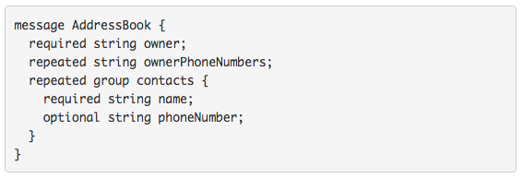
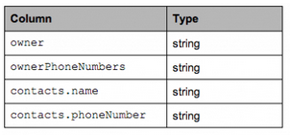
What about semi-structured data?
Required: exactly one occurrence
Optional: 0 or 1 occurrence
Repeated: 0 or more occurrences
Columnar Decomposition
What’s the issue?

Slide 39

What’s the solution?
Google’s Dremel storage model
Open-source implementation in Parquet
Source: https://blog.twitter.com/2013/dremel-made-simple-with-parquet

Slide 40
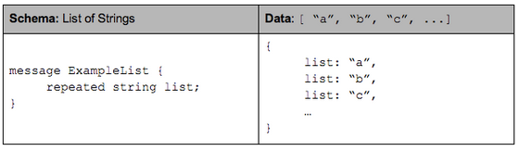
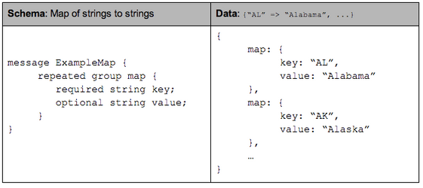
Optional and Repeated Elements

Slide 41
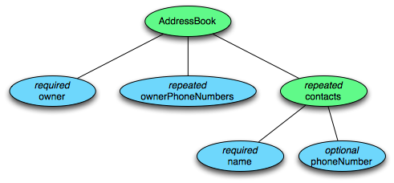
Tree Decomposition
Columnar Decomposition
What other information do we need to store?

Slide 42
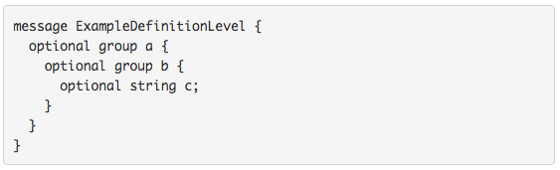
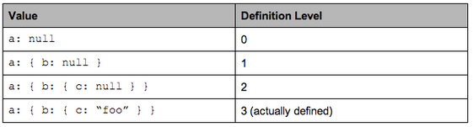
Definition Level

Slide 43
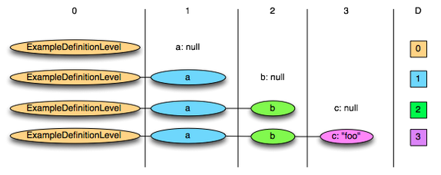
Definition Level: Illustration

Slide 44
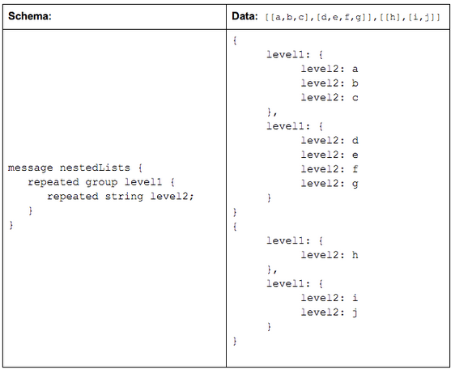
Repetition Level

Slide 45
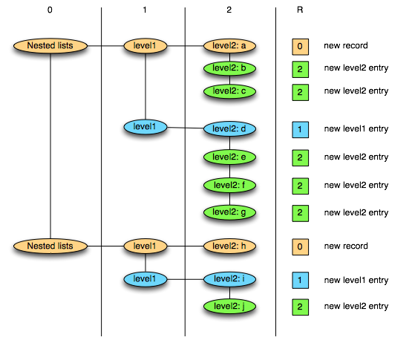
Repetition Level: Illustration
0 marks new record and implies creating a new level1 and level2 list
1 marks new level1 list and implies creating a new level2 list as well.
2 marks every new element in a level2 list.

Slide 46
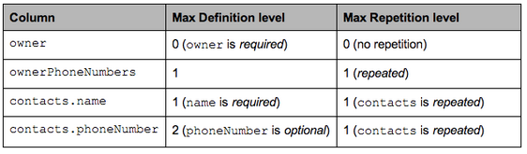
Putting It Together
Columnar Decomposition

Slide 47
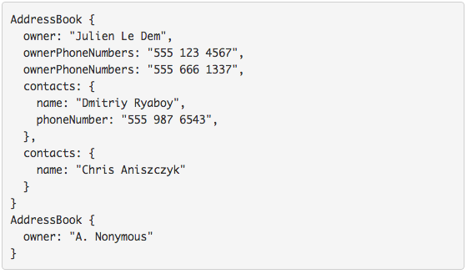
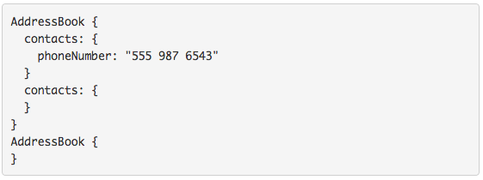
Sample Projection
Project onto contacts.phoneNumber

Slide 48
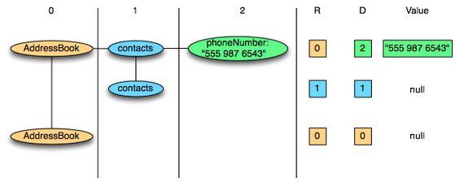
Physical Layout
Columnar Decomposition
Efficient Representations?

Slide 49
Key Ideas
Binary representations are good
Binary representations need schemas
Schemas allow logical/physical separation
Logical/physical separation allows you to do cool things

Slide 50
A Major Step Backwards?
MapReduce is a step backward in database access:
Schemas are good
Separation of the schema from the application is good
High-level access languages are good
MapReduce is poor implementation
Brute force and only brute force (no indexes, for example)
MapReduce is not novel
MapReduce is missing features
Bulk loader, indexing, updates, transactions…
MapReduce is incompatible with DMBS tools
Source: Blog post by DeWitt and Stonebraker

Slide 51
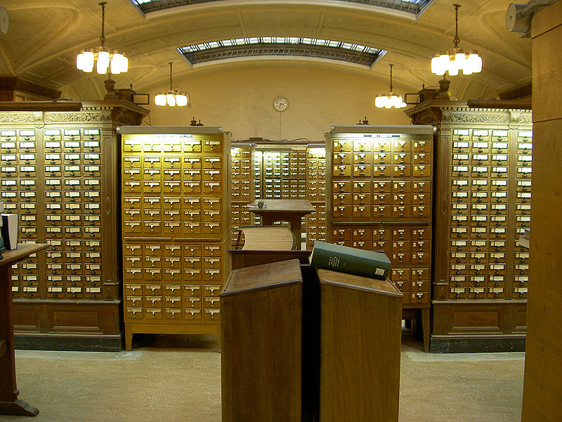
Indexes are a good thing!
Source: Wikipedia (Card Catalog)

Slide 52
Hadoop + Full-Text Indexes
status = load ’/tables/statuses/2011/03/01’
using StatusProtobufPigLoader()
as (id: long, user_id: long, text: chararray, ...);
filtered = filter status by text matches ’.*\\bhadoop\\b.*’;
…
Pig performs a brute force scan
Stupid.
Then promptly chucks out most of the data
Source: Lin et al. (2011) Full-Text Indexing for Optimizing Selection Operations in Large-Scale Data Analytics. MAPREDUCE Workshop.

Slide 53
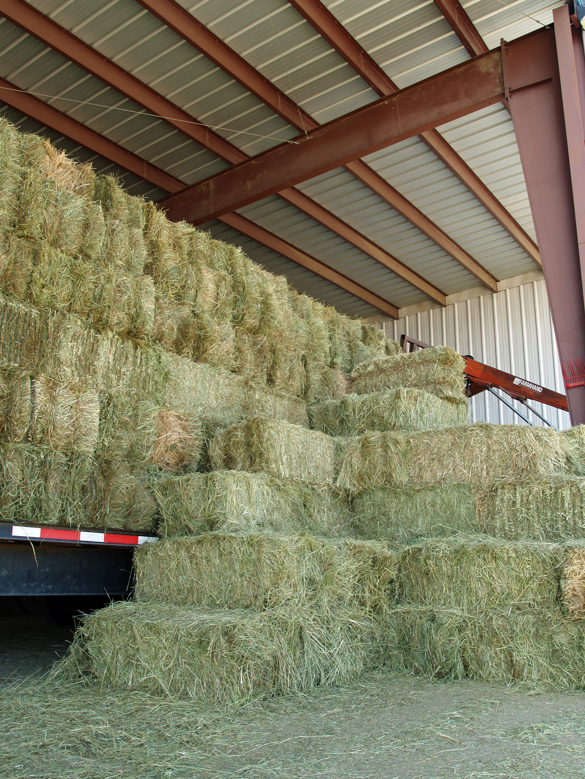
“Trying to find a needle in a haystack… with a snowplow”
@squarecog

Slide 54
Hadoop + Full-Text Indexes
status = load ’/tables/statuses/2011/03/01’
using StatusProtobufPigLoader()
as (id: long, user_id: long, text: chararray, ...);
filtered = filter status by text matches ’.*\\bhadoop\\b.*’;
…
Pig performs a brute force scan
Stupid.
Then promptly chucks out most of the data
Uhhh… how about an index?
Use Lucene full-text index

Slide 55
Client
LZO blocks
…
…
InputSplit
InputSplit
InputSplit
Mapper
Mapper
Mapper

Slide 56
Index-time
Lucene
Index
…
…
LZO blocks
…
…
Index for selection on tweet content
Build “pseudo-document” for each Lzo block
Index pseudo-documents with Lucene

Slide 57
Run-time
Lucene
Index
Client
LZO blocks
…
…
InputSplit
InputSplit
InputSplit
Mapper
Mapper
Mapper
Only process blocks known to satisfy selection criteria

Slide 58
Hadoop Integration
Everything encapsulated in the InputFormat
RecordReaders know what blocks to process and skip
Completely transparent to mappers

Slide 59
Experiments
Selection on tweet content
Varied selectivity range
One day sample data (70m tweets, 8/1/2010)

Slide 60
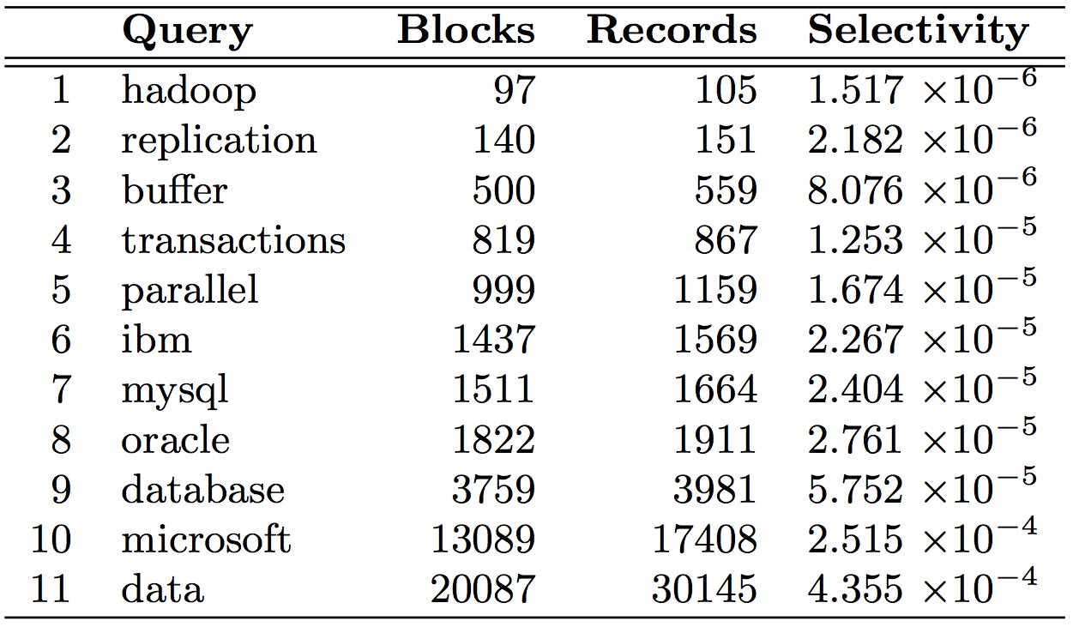

Slide 61
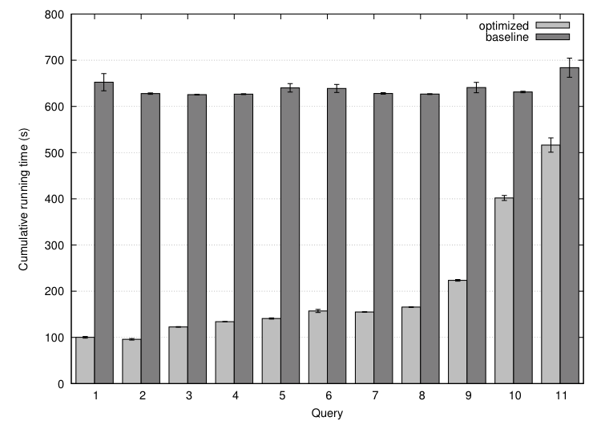

Slide 62
Analytical model
Task: prediction LZO blocks scanned by selectivity
Poisson model: P(observing k occurrences in a block)
E(fraction of blocks scanned):

Slide 63
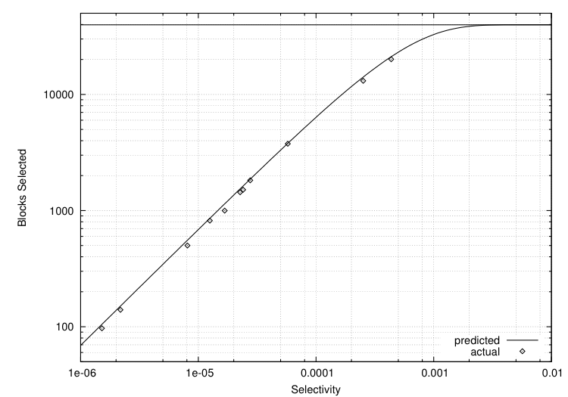
Selectivity 0.001 → 82% of all blocks
Selectivity 0.002 → 97% of all blocks
Total: ~40k blocks
But: can predict a priori!

Slide 64
A Major Step Backwards?
MapReduce is a step backward in database access:
Schemas are good
Separation of the schema from the application is good
High-level access languages are good
MapReduce is poor implementation
Brute force and only brute force (no indexes, for example)
MapReduce is not novel
MapReduce is missing features
Bulk loader, indexing, updates, transactions…
MapReduce is incompatible with DMBS tools
Source: Blog post by DeWitt and Stonebraker

Slide 65

Questions?
Source: Wikipedia (Japanese rock garden)

